Slide 1
[AI2 MAX Soundbar STB]
Standby Mode definition(Active Standby vs Passive Standby)
Organization
R&D Lab. 2
Issued Date
2021.05.24
Version
0.11

Slide 2
Revision History
Version | Date | Description | Owner
0.1 | 2021/05/21 | 1st Draft version | Lonnie Kim
0.11 | 2021/05/24 | 5V_EN function changed from CTRL_A113X to AMP_PWM_OFF | Lonnie Kim

Slide 3
Active & Passive Standby

Slide 4
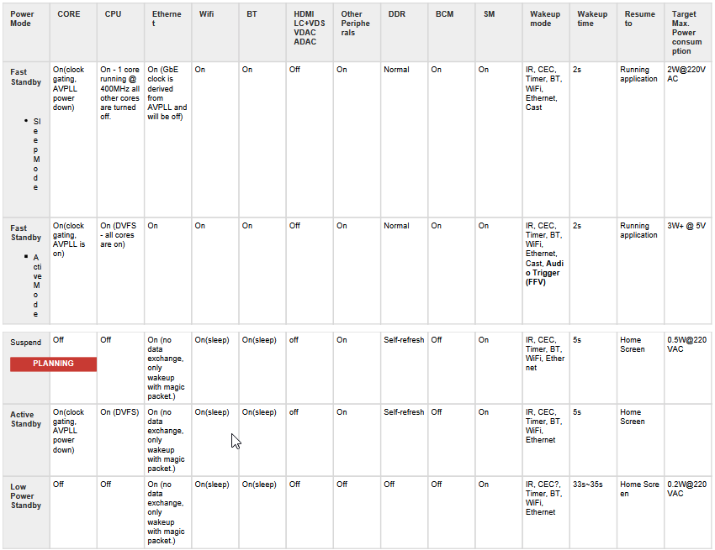
Active Standby Condition
HDMI output OFF
Ethernet ON
FFV MIC ON
BT ON
A113X ON
AMP IC:
1) Below Register OFF
through I2C
- SHDN(Shut down)
- PWM

Slide 5
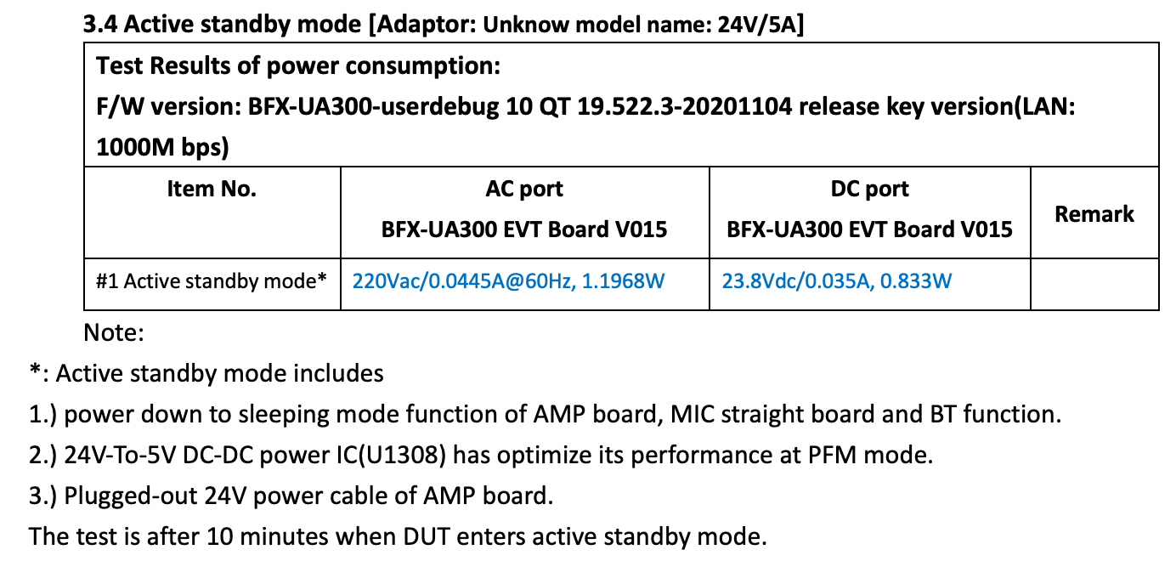
Passive Standby Condition(Phase 1): Under 2W
HDMI output OFF
Ethernet ON
FFV MIC Sleep Mode
BT Sleep Mode
A113X OFF
AMP IC OFF
(A113X & AMP: appendix)

Slide 6
APPENDIX

Slide 7
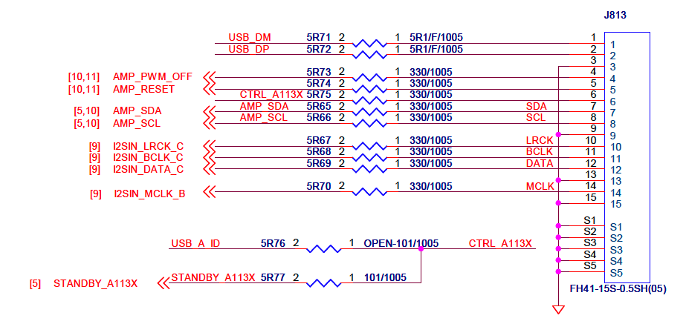
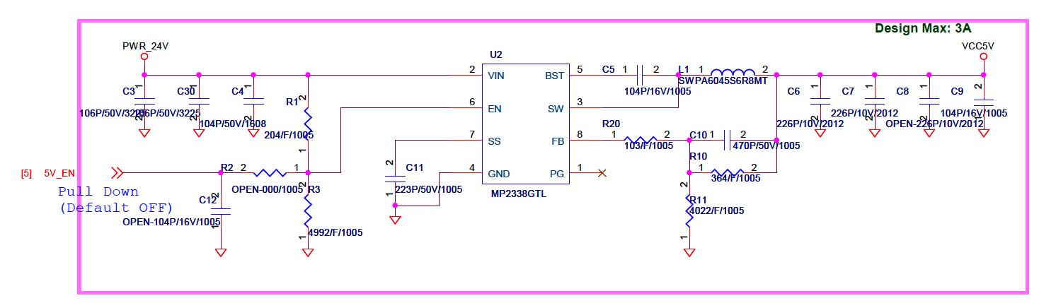
APPENDIX(Will apply Mass production)
A113X OFF
AMP IC OFF
Using “AMP_PWM_OFF”(J813 pin4)
→ AMP_PWM_OFF connected to 5V_EN
(VS550 can control Audio Amp block’s power)
→ J813 Pin4: AMP_PWM_OFF -> 5V_EN
(SoC Board: PD_AD83586B, J814 Pin4)
→ Enable Audio Amp Block
> 5V_EN : High
> I2C Control(initialize)
→ Disable Audio Amp Block
> I2C Control(Off)
> 5V_EN : Low

Slide 8
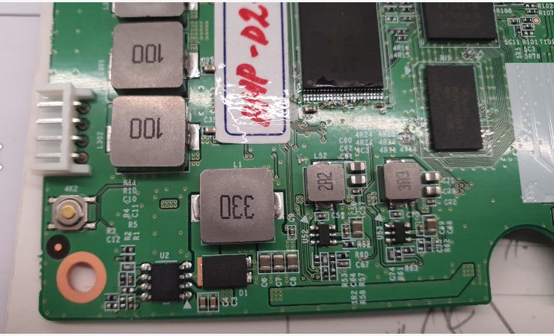
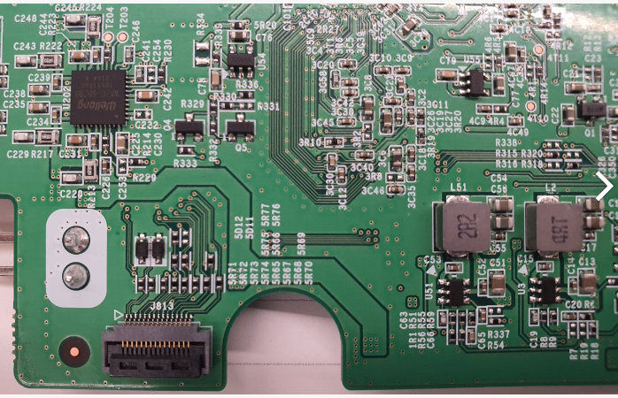
APPENDIX(Rework Points)
5R73 open
Connect 5R73 pin1 and R2 pin1
R2
5R73

Slide 9
Thank you.

